Slide 1
Students: Asaf Gendler
Supervisor: Dr. Yaniv Romano

Slide 2
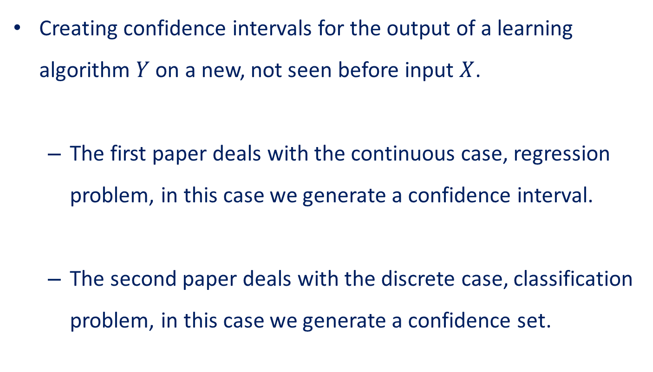
What is the goal?
Creating confidence intervals for the output of a learning algorithm $Y$ on a new, not seen before input $X$.
  The first paper deals with the continuous case, regression problem, in this case we generate a confidence interval.
  The second paper deals with the discrete case, classification problem, in this case we generate a confidence set.

Slide 3
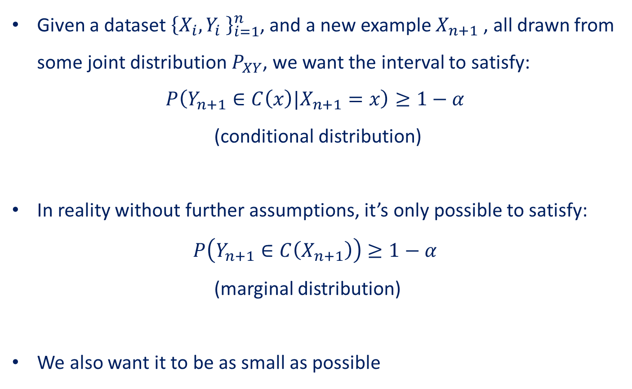
What is the goal?
Given a dataset ${\left\{X_{i},Y_{i} \right\}}_{i=1}^{n}$, and a new example $X_{n+1}$ , all drawn from some joint distribution $P_{XY}$, we want the interval to satisfy:
$$P\left(Y_{n+1}∈C\left(x\right)|X_{n+1}=x\right)≥1−α$$
(conditional distribution)
In reality without further assumptions, it’s only possible to satisfy:
$$P\left(Y_{n+1}∈C\left(X_{n+1}\right)\right)≥1−α$$
(marginal distribution)
We also want it to be as small as possible

Slide 4
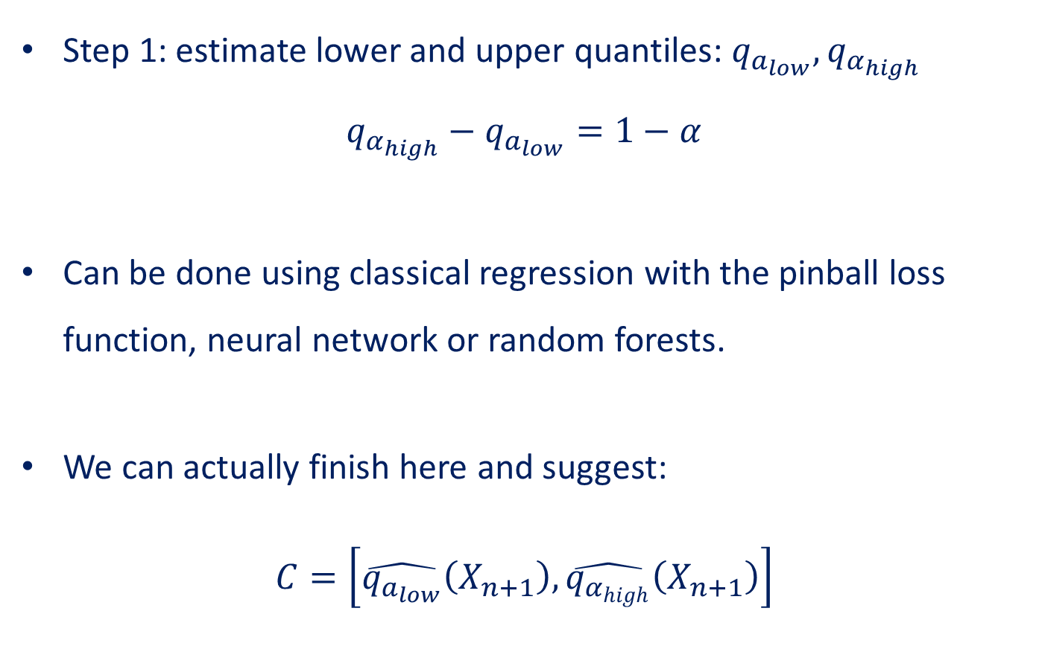
Continuous case
Step 1: estimate lower and upper quantiles: $q_{a_{low}},q_{α_{high}}$
$$q_{α_{high}}−q_{a_{low}}=1−α$$
Can be done using classical regression with the pinball loss function, neural network or random forests.
We can actually finish here and suggest:
$$C=\left[\hat{q_{a_{low}}}\left(X_{n+1}\right),\hat{q_{α_{high}}}\left(X_{n+1}\right)\right]$$
Notes:
זה לא מספר זה פונקצייה

Slide 5
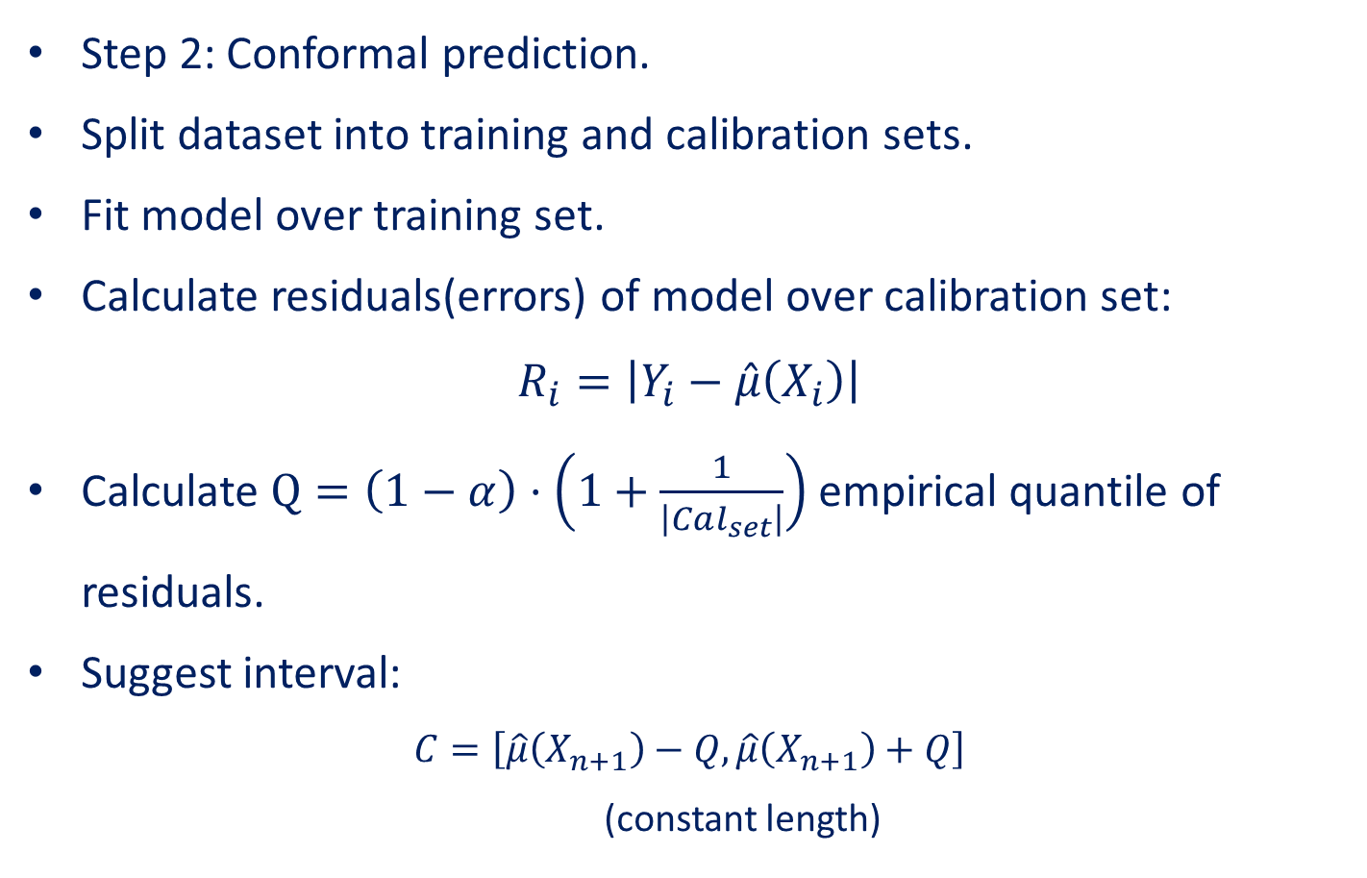
Continuous case
Step 2: Conformal prediction.
Split dataset into training and calibration sets.
Fit model over training set.
Calculate residuals(errors) of model over calibration set:
$$R_{i}=\left|Y_{i}−\hat{μ}\left(X_{i}\right)\right|$$
Calculate $Q=\left(1−α\right)⋅\left(1+\frac{1}{\left|Cal_{set}\right|}\right)$empirical quantile of residuals.
Suggest interval:
$$C=\left[\hat{μ}\left(X_{n+1}\right)−Q,\hat{μ}\left(X_{n+1}\right)+Q\right]$$
(constant length)
Notes:
מקיים את הדרישה על ההסתברות השולית

Slide 6
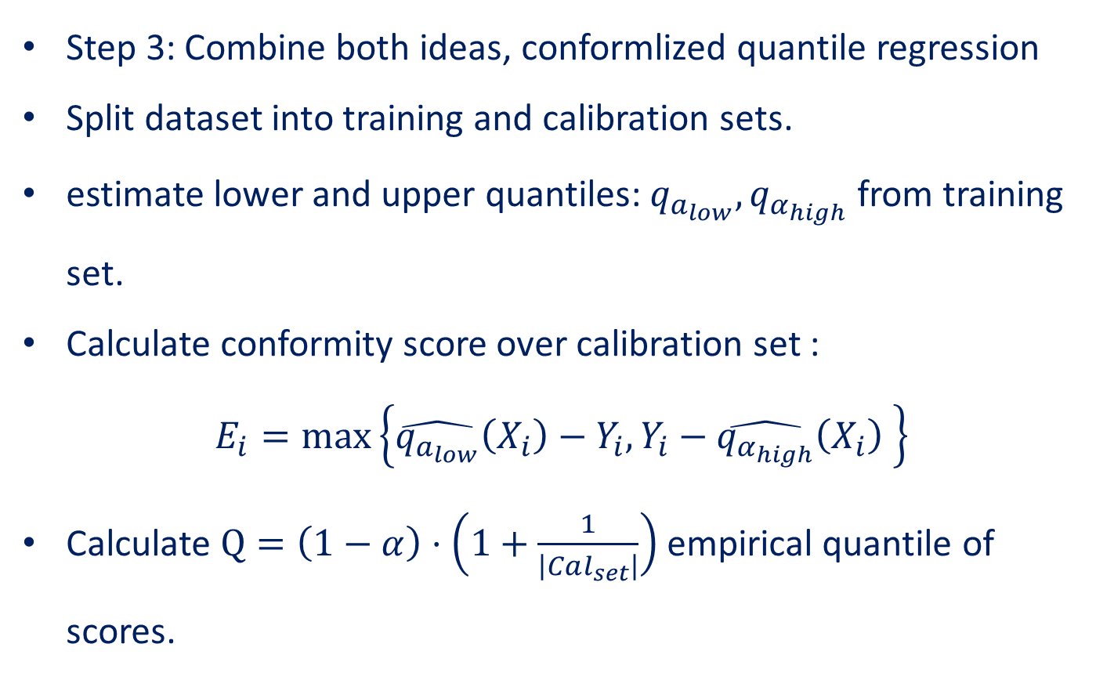
Continuous case
Step 3: Combine both ideas, conformlized quantile regression
Split dataset into training and calibration sets.
estimate lower and upper quantiles: $q_{a_{low}},q_{α_{high}}$ from training set.
Calculate conformity score over calibration set :
$$E_{i}=\max\left\{\hat{q_{a_{low}}}\left(X_{i}\right)−Y_{i},Y_{i}−\hat{q_{α_{high}}}\left(X_{i}\right) \right\}$$
Calculate $Q=\left(1−α\right)⋅\left(1+\frac{1}{\left|Cal_{set}\right|}\right)$empirical quantile of scores.

Slide 7

Continuous case
Suggest interval:
$$C=\left[\hat{q_{a_{low}}}\left(X_{n+1}\right)−Q,\hat{q_{α_{high}}}\left(X_{n+1}\right)+Q\right]$$
(not constant length)
Notes:
מקיים את הדרישה על ההסתברות השולית וגם גודל האינטרוול לא קבוע לכל קלט.

Slide 8


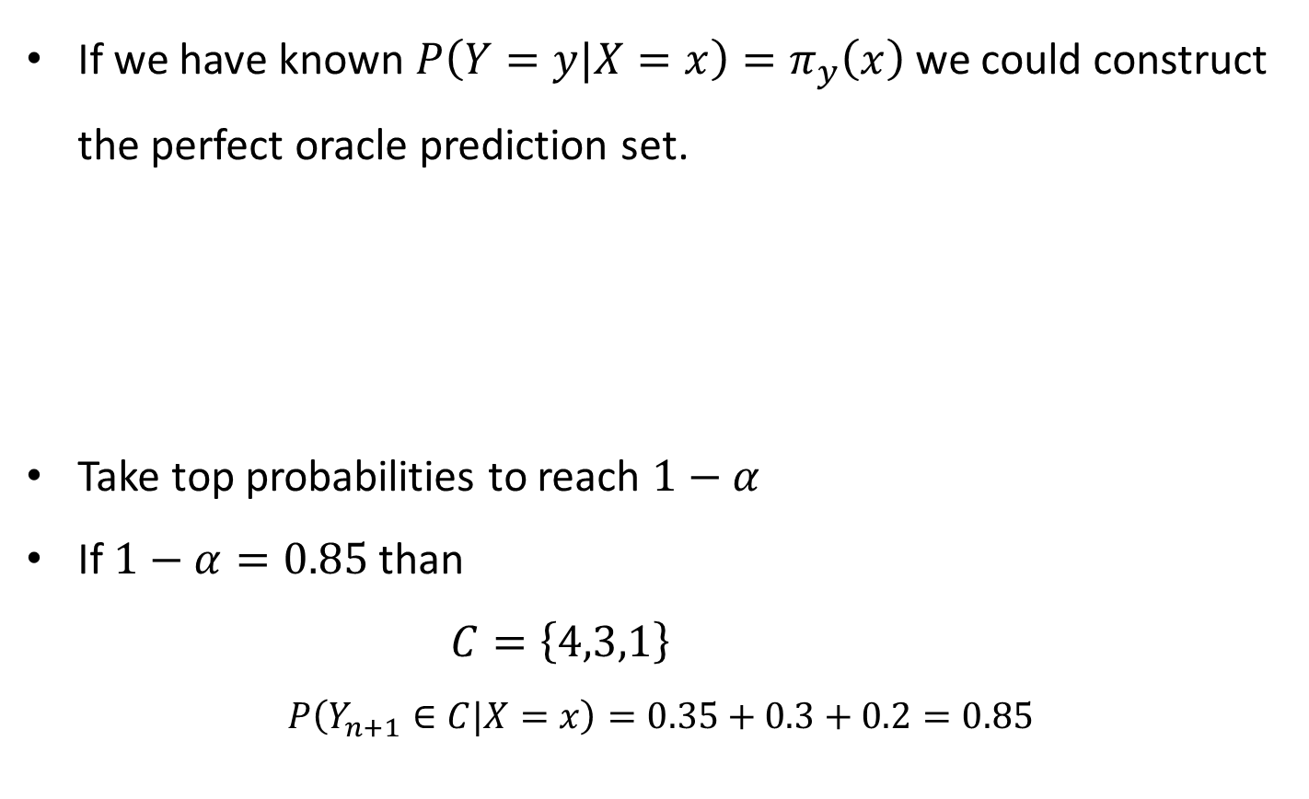








Discrete case
If we have known $P\left(Y=y|X=x\right)=π_{y}\left(x\right)$ we could construct the perfect oracle prediction set.
Take top probabilities to reach $1−α$
If $1−α=0.85$ than
$C=\left\{4,3,1\right\}$
$$P\left(Y_{n+1}∈C|X=x\right)=0.35+0.3+0.2=0.85$$
$$π_{1}\left(x\right)=0.2$$
$$π_{2}\left(x\right)=0.1$$
$$π_{3}\left(x\right)=0.3$$
$$π_{4}\left(x\right)=0.35$$
$$π_{5}\left(x\right)=0.05$$
$$π_{4}\left(x\right)=0.35$$
$$π_{3}\left(x\right)=0.3$$
$$π_{1}\left(x\right)=0.2$$
$$π_{2}\left(x\right)=0.1$$
$$π_{5}\left(x\right)=0.05$$
Notes:
מקיים את הדרישה על ההסתברות השולית וגם גודל האינטרוול לא קבוע לכל קלט.

Slide 9


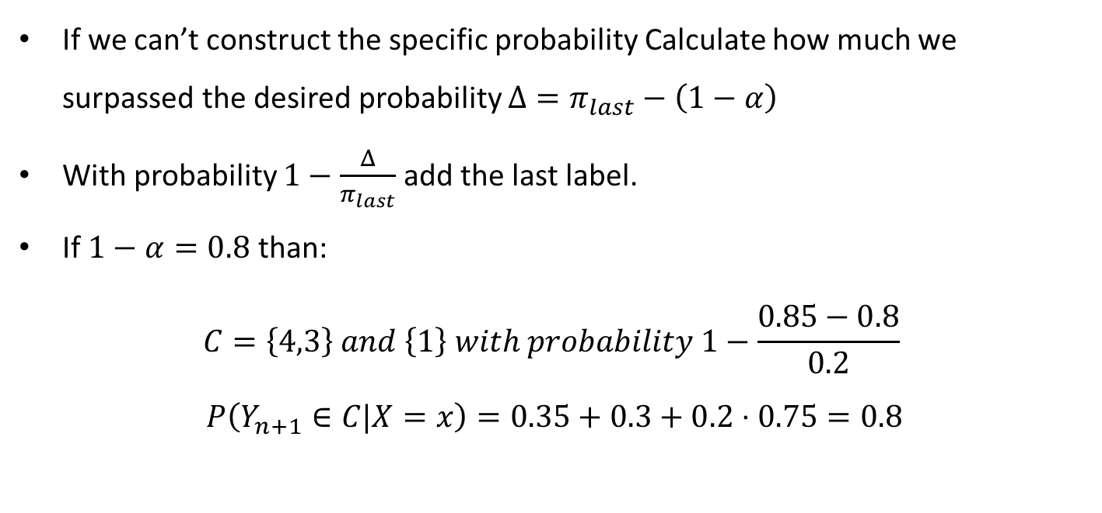








Discrete case
$$π_{1}\left(x\right)=0.2$$
$$π_{2}\left(x\right)=0.1$$
$$π_{3}\left(x\right)=0.3$$
$$π_{4}\left(x\right)=0.35$$
$$π_{5}\left(x\right)=0.05$$
$$π_{4}\left(x\right)=0.35$$
$$π_{3}\left(x\right)=0.3$$
$$π_{1}\left(x\right)=0.2$$
$$π_{2}\left(x\right)=0.1$$
$$π_{5}\left(x\right)=0.05$$
If we can’t construct the specific probability Calculate how much we surpassed the desired probability ${Δ=π}_{last}−\left(1−α\right)$
With probability $1−\frac{Δ}{π_{last}}$ add the last label.
If $1−α=0.8$ than:
$$C=\left\{4,3\right\} and \left\{1\right\} with probability 1−\frac{0.85−0.8}{0.2}$$
$$P\left(Y_{n+1}∈C|X=x\right)=0.35+0.3+0.2⋅0.75=0.8$$
Notes:
מקיים את הדרישה על ההסתברות השולית וגם גודל האינטרוול לא קבוע לכל קלט.

Slide 10
Discrete case
$$π_{1}\left(x\right)=0.2$$
$$π_{2}\left(x\right)=0.1$$
$$π_{3}\left(x\right)=0.3$$
$$π_{4}\left(x\right)=0.35$$
$$π_{5}\left(x\right)=0.05$$
$$π_{4}\left(x\right)=0.35$$
$$π_{3}\left(x\right)=0.3$$
$$π_{1}\left(x\right)=0.2$$
$$π_{2}\left(x\right)=0.1$$
$$π_{5}\left(x\right)=0.05$$
What do we do if there is a tie?
Notes:
מקיים את הדרישה על ההסתברות השולית וגם גודל האינטרוול לא קבוע לכל קלט.

Slide 11
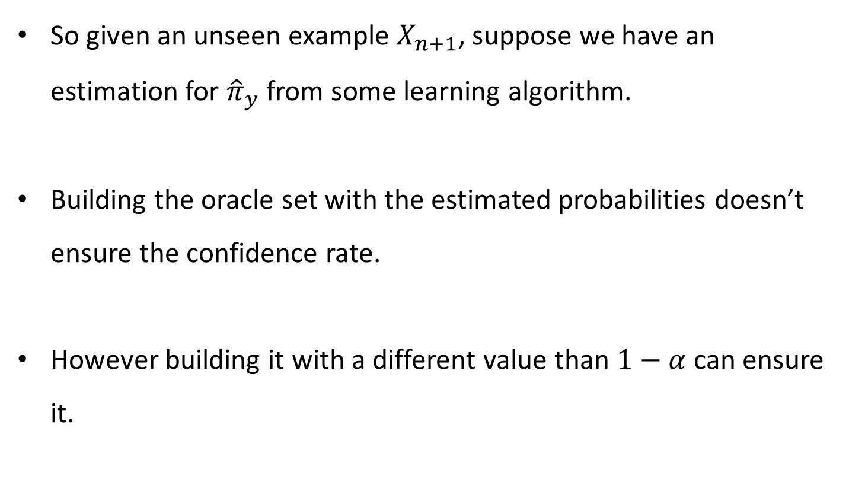
Discrete case
So given an unseen example $X_{n+1}$, suppose we have an estimation for ${\hat{π}}_{y}$ from some learning algorithm.
Building the oracle set with the estimated probabilities doesn’t ensure the confidence rate.
However building it with a different value than $1−α$ can ensure it.
Notes:
מקיים את הדרישה על ההסתברות השולית וגם גודל האינטרוול לא קבוע לכל קלט.

Slide 12


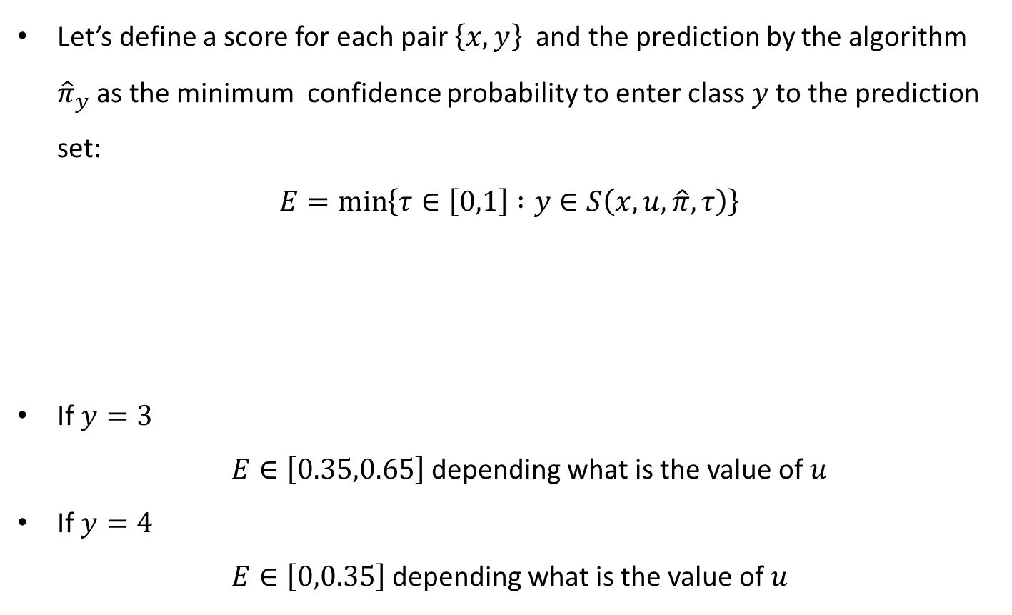








Discrete case
Let’s define a score for each pair $\left\{x,y\right\}$and the prediction by the algorithm ${\hat{π}}_{y}$ as the minimum confidence probability to enter class $y$ to the prediction set:
$$E=\min\left\{τ∈\left[0,1\right] :y∈S\left(x,u,\hat{π},τ\right)\right\}$$
If $y=3$
$E∈\left[0.35,0.65\right]$ depending what is the value of $u$
If $y=4$
$E∈\left[0,0.35\right]$ depending what is the value of $u$
$$π_{1}\left(x\right)=0.2$$
$$π_{2}\left(x\right)=0.1$$
$$π_{3}\left(x\right)=0.3$$
$$π_{4}\left(x\right)=0.35$$
$$π_{5}\left(x\right)=0.05$$
$$π_{4}\left(x\right)=0.35$$
$$π_{3}\left(x\right)=0.3$$
$$π_{1}\left(x\right)=0.2$$
$$π_{2}\left(x\right)=0.1$$
$$π_{5}\left(x\right)=0.05$$
Notes:
מקיים את הדרישה על ההסתברות השולית וגם גודל האינטרוול לא קבוע לכל קלט.

Slide 13

Discrete case
Why $E_{i}$ are distributed uniform if the prediction is correct?
We can look at $E$ as a generalized CDF of $Y$ given $X$
Those $E\sim U\left[0,1\right]$ given $X$;
Notes:
מקיים את הדרישה על ההסתברות השולית וגם גודל האינטרוול לא קבוע לכל קלט.

Slide 14
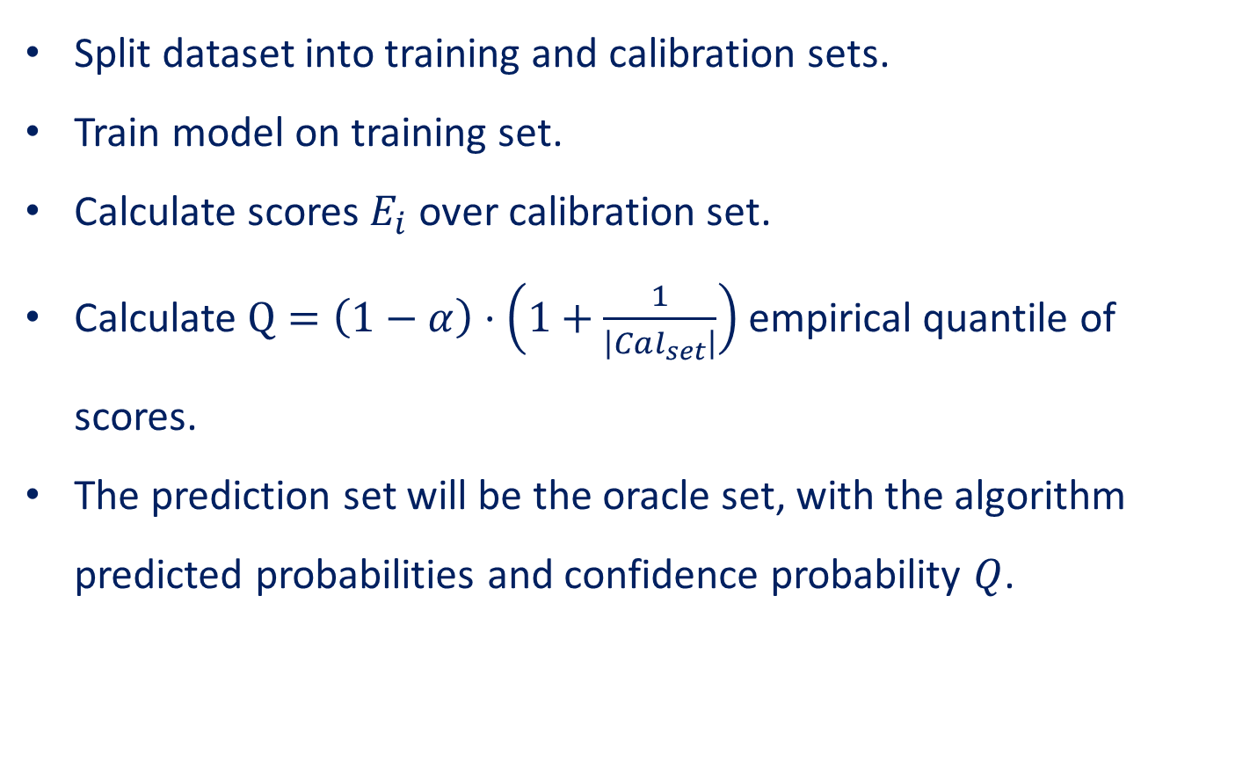
Discrete case
Split dataset into training and calibration sets.
Train model on training set.
Calculate scores $E_{i}$ over calibration set.
Calculate $Q=\left(1−α\right)⋅\left(1+\frac{1}{\left|Cal_{set}\right|}\right)$empirical quantile of scores.
The prediction set will be the oracle set, with the algorithm predicted probabilities and confidence probability $Q$.

Slide 15
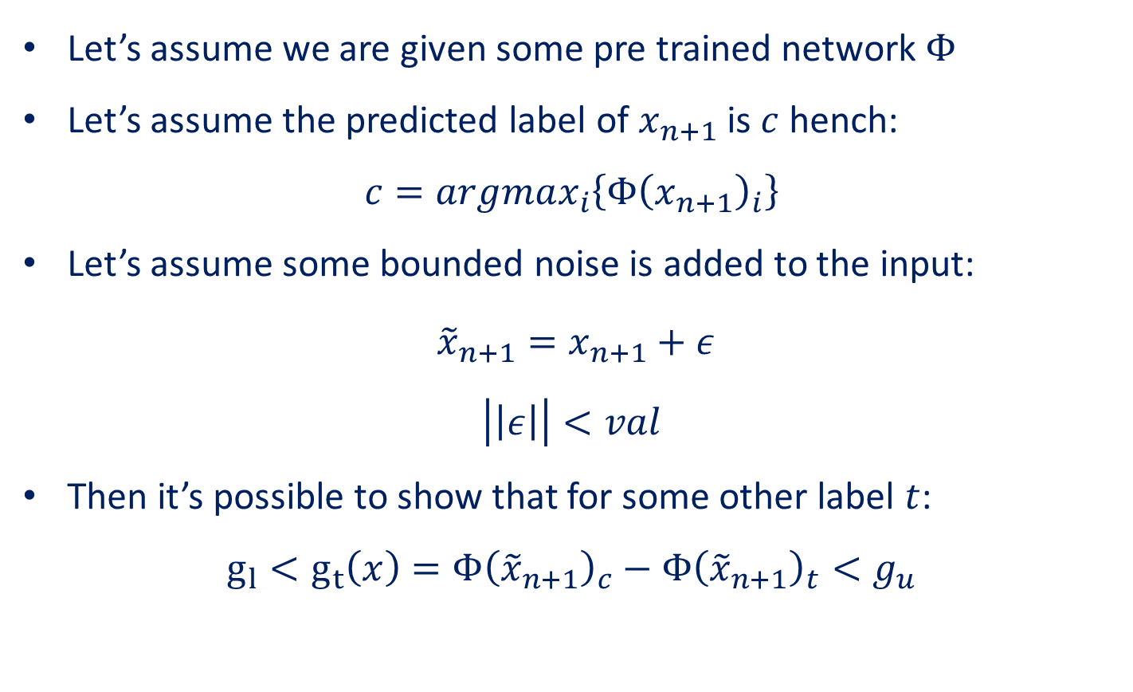
Bounding output
Let’s assume we are given some pre trained network $Φ$
Let’s assume the predicted label of $x_{n+1}$is $c$ hench:
$$c=argmax_{i}\left\{Φ{\left(x_{n+1}\right)}_{i}\right\}$$
Let’s assume some bounded noise is added to the input:
$${\tilde{x}}_{n+1}=x_{n+1}+ε$$
$$\left|\left|ε\right|\right|<val$$
Then it’s possible to show that for some other label $t$:
$$g_{l}<g_{t}\left(x\right)=Φ{\left({\tilde{x}}_{n+1}\right)}_{c}−Φ{\left({\tilde{x}}_{n+1}\right)}_{t}<g_{u}$$

Slide 16
Discrete case
Cross Validation method?
Proofs?
Notes:
מקיים את הדרישה על ההסתברות השולית וגם גודל האינטרוול לא קבוע לכל קלט.

Slide 17
Questions?
Heteroskedascity??
Homoskedastic??
Exchangeably??

